Slide 1

BERT: Pre-training of Deep Bidirectional Transformers for Language Understanding
Submitted by:
Mohammad Aman Ullah Khan
ID: 19301139, Course: CSE 438,
Department of Computer Science & Engineering.
Submitted to: Mr. Annajiat Alim Rasel Sir
01

Slide 2
Outline
What is BERT?
Limitations of current techniques.
Significance for Large Training Data for BERT.
Masked Language Model (MLM).
Next Sentence Prediction (NSP).
Transformer Encoders.
State-of-the-Art NLP Language Models
Difference in pre-training model architectures.
Applications of BERT.
Question & Answer Session.
02

Slide 3

What is BERT?
Propose a new pre-training objective so that a deep bidirectional transformer can be trained.
• The "masked language model" (MLM): the objective is to predict the original word of a masked word based only on its context.
• "Next sentence prediction"
Contextual Comprehension
• BERT uses surrounding text to disambiguate words and understand context.
03

Slide 4
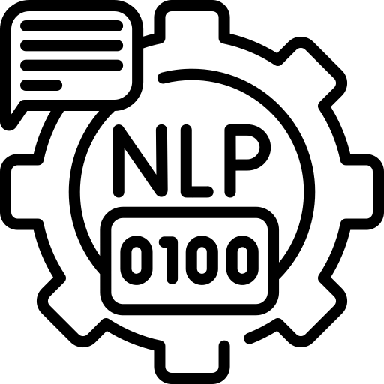
Limitations of current techniques
Language models in pre-training are unidirectional, it process text in only one direction, either left-to-right or right-to-left.
• OpenAl GPT used left-to-right architecture.
• ELMo concatenates forward and backward language models.
Solution:
BERT: Bidirectional Encoder Representations
from Transformers.
04

Slide 5
Significance for Large Training Data for BERT
Large Amounts of Training Data
BERT's success is attributed to its training on a massive dataset.
A dataset containing a staggering 3.3 billion words has been instrumental in BERT's achievements.
The Data Sources
BERT was specifically trained on:
Wikipedia (~2.5 billion words)
Google’s BooksCorpus (~800 million words)
These diverse and extensive informational datasets contribute to BERT's profound knowledge.
Training Duration and Scaling
Training on such a large dataset is time-consuming.
BERT's training was made possible by:
The novel Transformer architecture.
Utilization of TPUs (Tensor Processing Units), Google's custom circuits designed for large ML models.
Remarkably, 64 TPUs trained BERT in just 4 days.
Meeting Computational Demands
As BERT gained popularity, there was an increasing demand for smaller models to fit into less powerful devices.
In response, 23 smaller BERT models were released in March 2020.
05

Slide 6
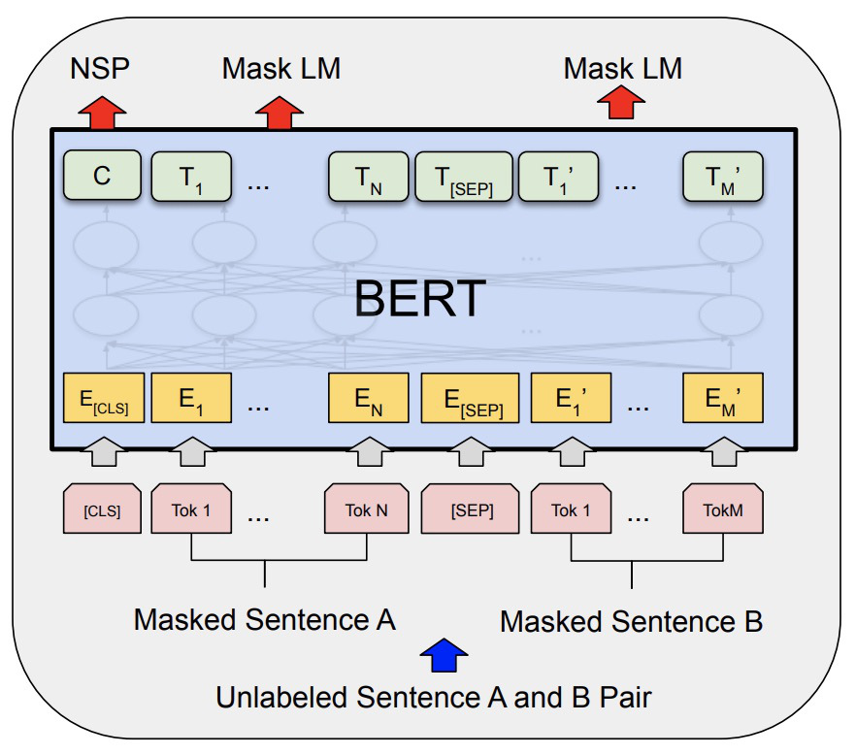
Masked Language Model (MLM)
MLM in BERT
MLM is a vital component of BERT's pre-training process.
It plays a crucial role in enhancing language understanding.
Bidirectional Learning
MLM enables BERT to learn bidirectionally from text.
Achieved by masking (hiding) words within sentences.
Contextual Prediction
BERT predicts masked words using context from both sides.
A revolutionary approach in natural language understanding.
Boosting NLP Performance
MLM contributes to BERT's deep knowledge of language.
It empowers BERT to excel in a wide range of NLP tasks.
06

Slide 7
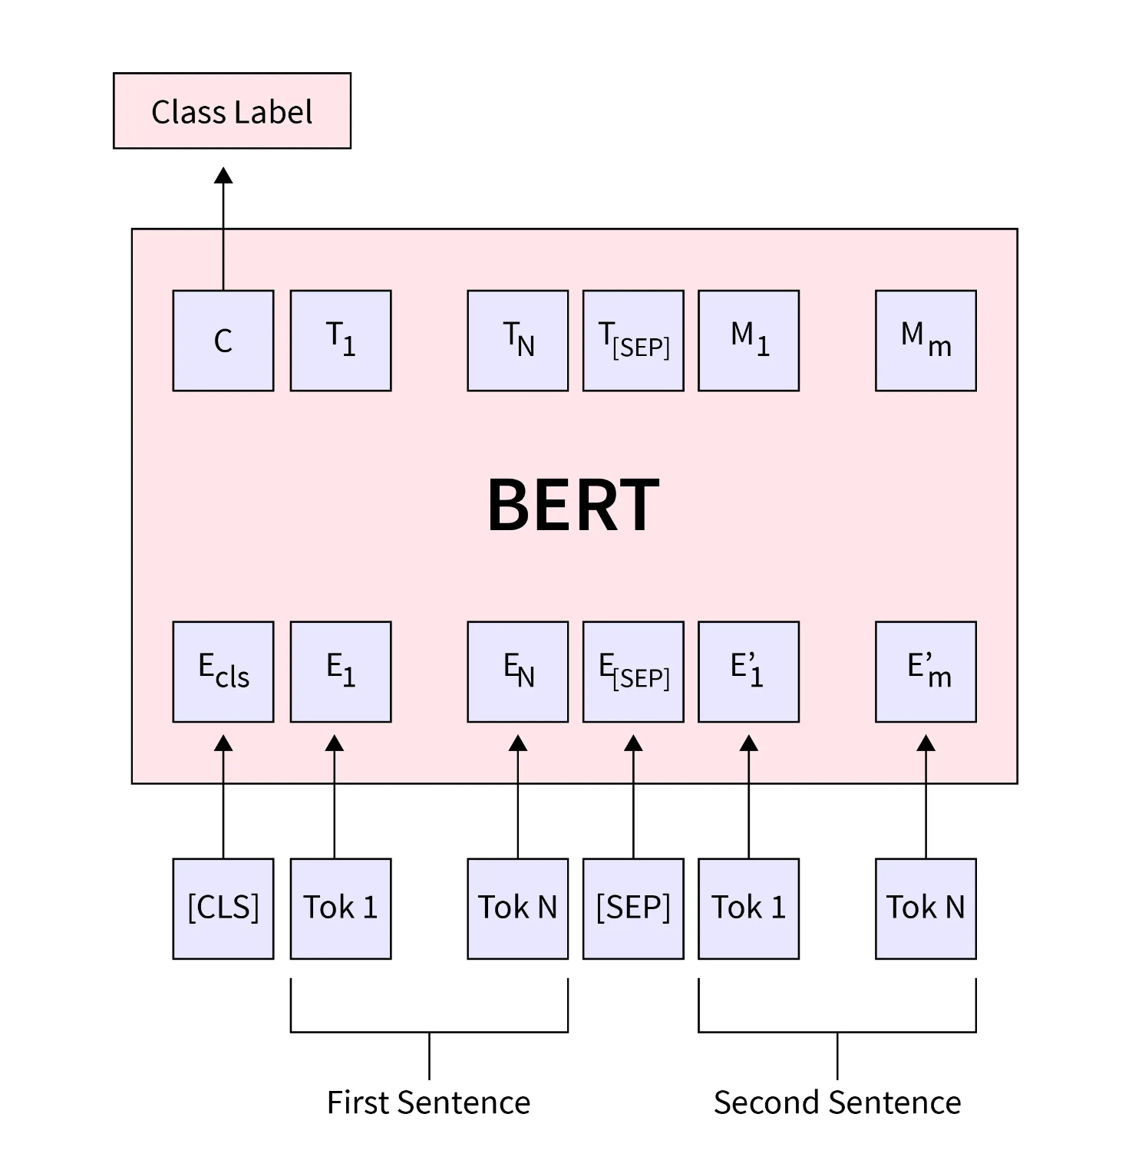
Next Sentence Prediction (NSP)
What is NSP?
NSP is a fundamental component of BERT's training process.
Sentence-Level Comprehension
contextual relationships between sentences.
Goes beyond understanding isolated sentences.
Predicting Sentence Pairs
BERT predicts whether a given sentence logically follows another.
Trains the model to understand sentence-level context and coherence.
Real-Life Analogy
Comparable to how humans connect ideas in conversations or stories.
Enhancing Language Understanding
Ability to comprehend discourse, making it more contextually aware.
07

Slide 8
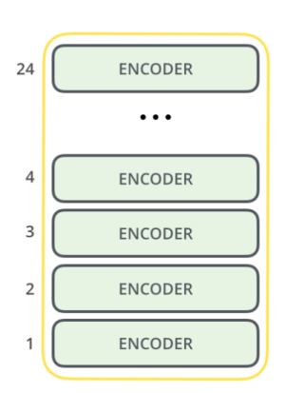
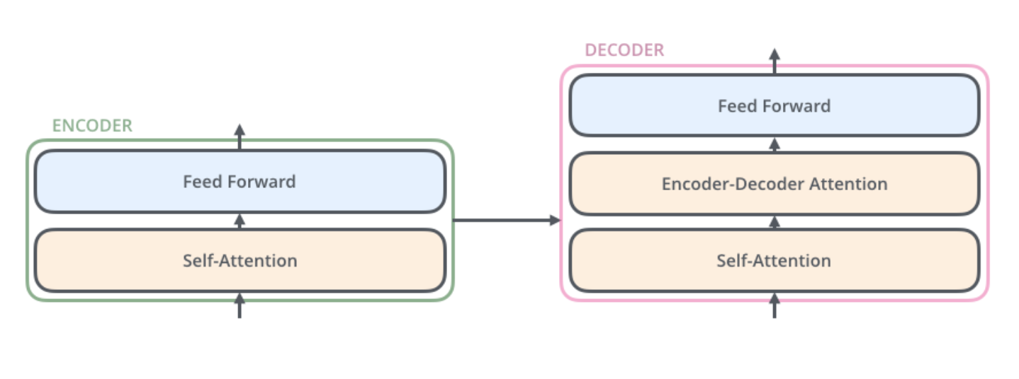
Transformer Encoders
Transformer in NLP
Transformer is an attention-based architecture for Natural Language Processing (NLP).
BERT's Foundation: BERT, or Bidirectional Encoder Representations from Transformers,
is a multi-layer bidirectional transformer encoder.
Two Components
Transformer consists of two main components:
Encoding component.
Decoding component.
08

Slide 9
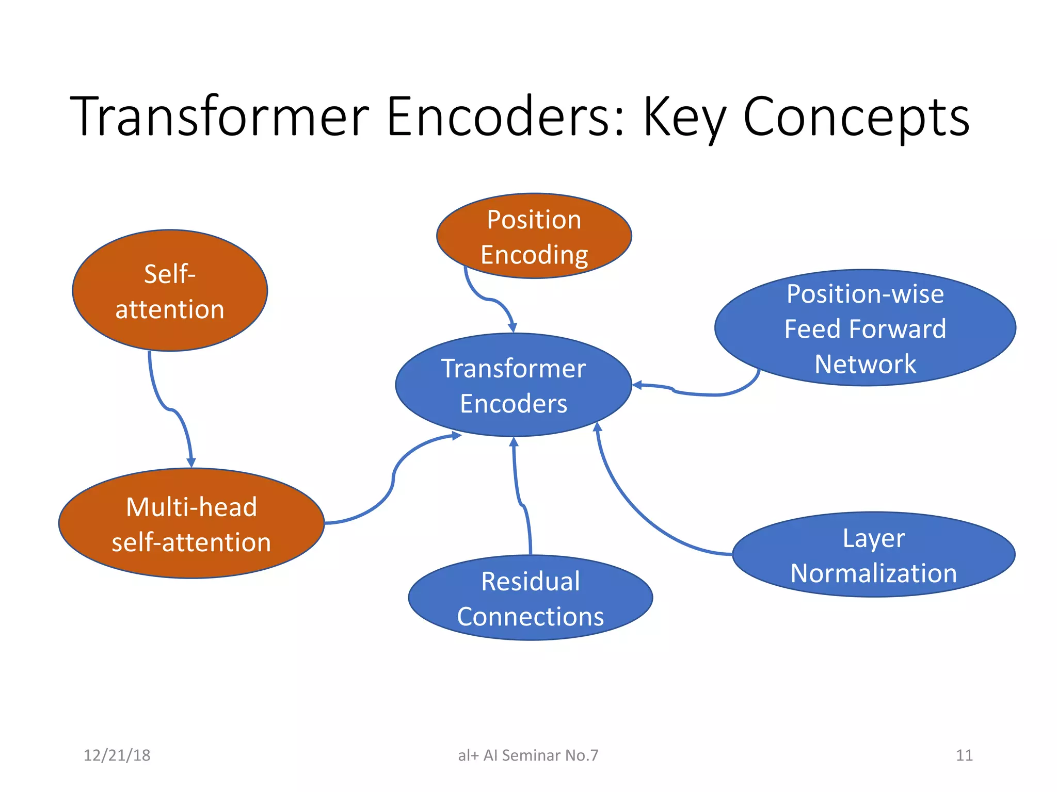
09

Slide 10
State-of-the-Art NLP Language Models
ELMo: Embeddings from Language Models
Bidirectional LSTM-based contextualized word representations.
Enhanced performance in sentiment analysis, named entity recognition, and question answering.
GPT: Generic Pre-trained Transformer
Transformer-based architecture.
Pre-trained on extensive text corpora.
Achieves cutting-edge results in text completion, summarization, and question answering.
XLNet: eXtreme Multi-task Learning via Adversarial Training
Transformer-based design.
Pre-trained on substantial text data.
Demonstrates excellence in text categorization, question answering, and natural language inference.
Common Traits
Pre-trained with vast datasets.
Employ advanced techniques like attention mechanisms, dropout, and multi-task learning.
10

Slide 11
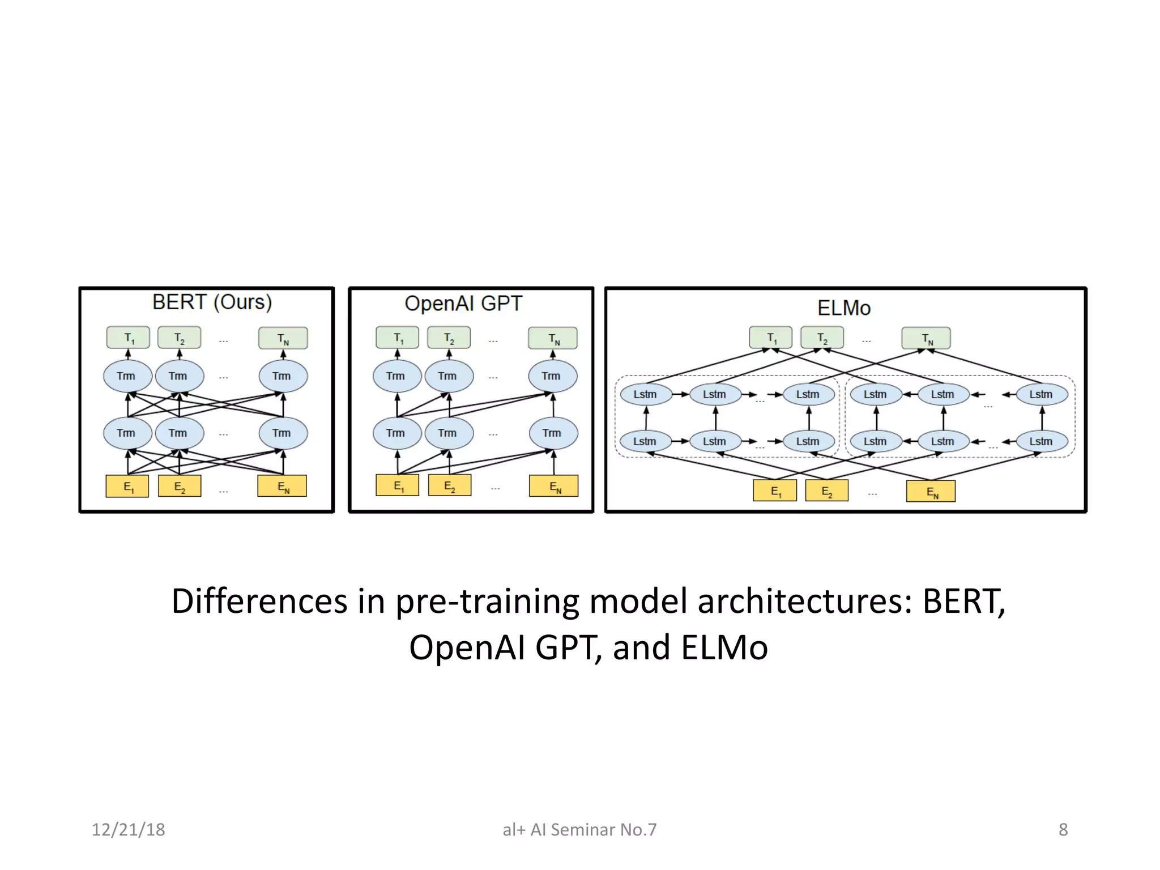
11

Slide 12

Applications of BERT
Context Matters
BERT excels at understanding context.
Consider both sides of each word.
Cross-Industry Impact
Enhances decision-making and automation.
Applied in healthcare, banking, e-commerce, and more.
Multilingual Support
Available in 103 languages.
BERT powers various NLP tasks:
Named entity recognition
Biomedical entity recognition
Sentiment analysis
Next-sentence prediction
Paraphrasing
Question-answering
Reading comprehension
12

Slide 13
Thank you so much.
Any questions, feel free to ask.
13

